Slide 1
C&A Plus 46 Signature Packet
April 19, 2018

Slide 2
Cover Letter
…
April 19, 2018
Final Screenshots Pages 3-6
Comparisons / Overlays Pages 7-20
- The final Screenshots, Comparisons and Overlays are included for your review
- Please sign where indicated on each page and return in order to initiate proto form development. If any alterations are needed, please let me know.
Please let me know if you have any questions.
Thanks & regards,
Sherie Ellis
Project Manager
Alvanon, Inc
212-868-4318 ext. 132
sherie.ellis@alvanon.com
Notes:
Picture is a Lee picture

Slide 3
C&A Plus 46 Screenshots

Slide 4
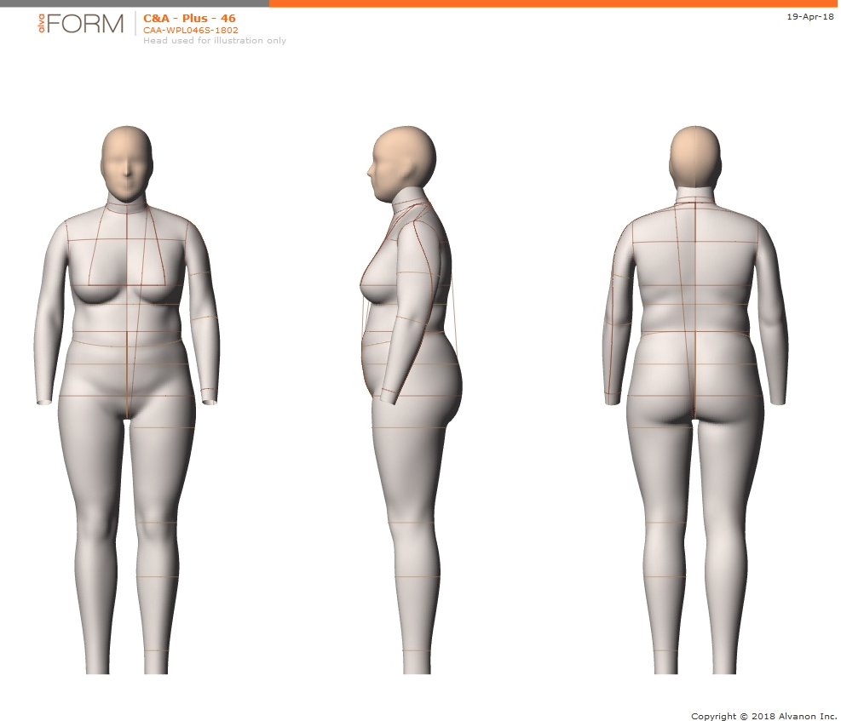
SIGN HERE
Notes:
Picture is a Lee picture

Slide 5
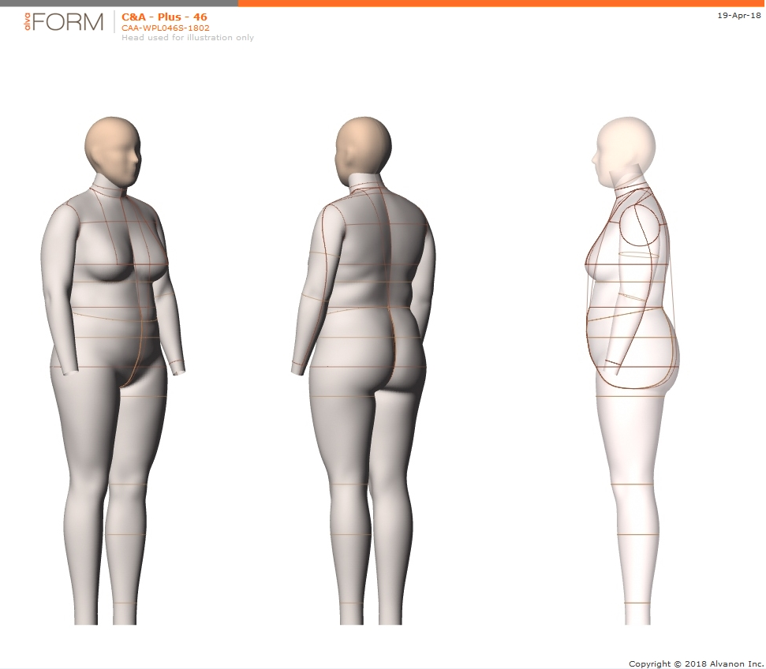
SIGN HERE
Notes:
Picture is a Lee picture

Slide 6
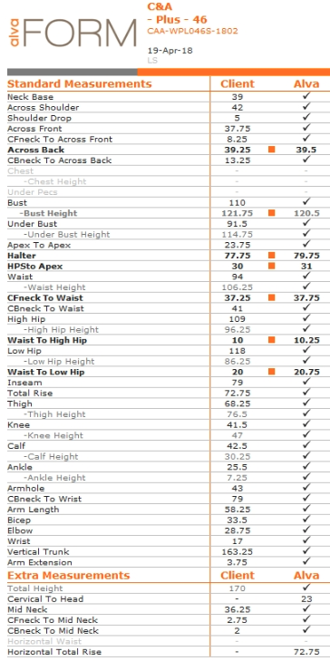
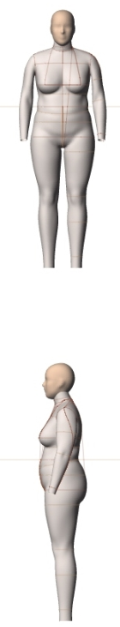
SIGN HERE
Notes:
Picture is a Lee picture

Slide 7
Comparisons & Overlays

Slide 8
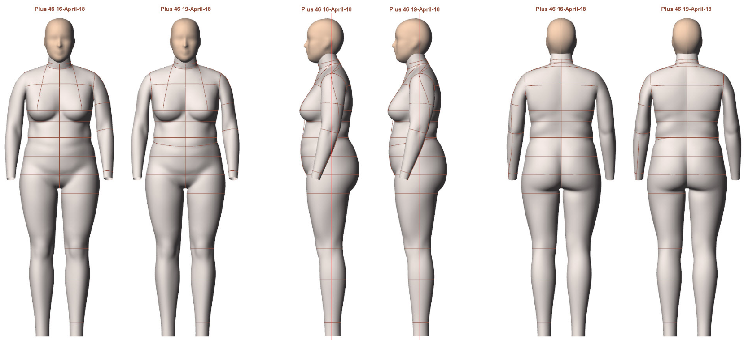

Slide 9
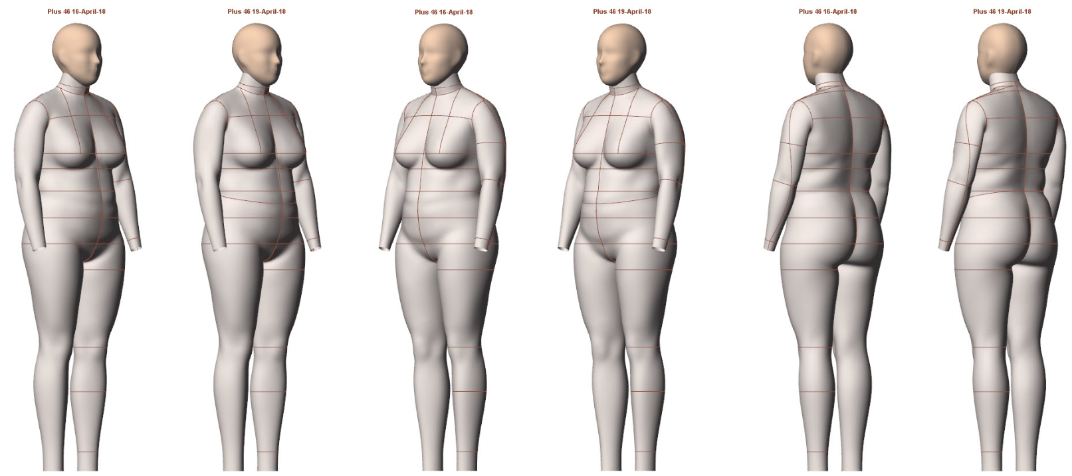

Slide 10

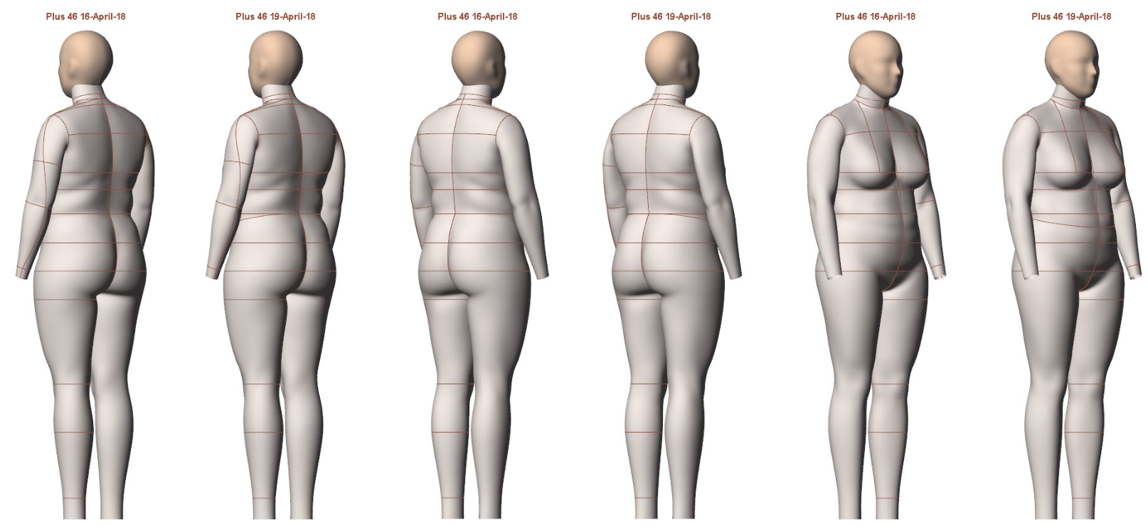

Slide 11
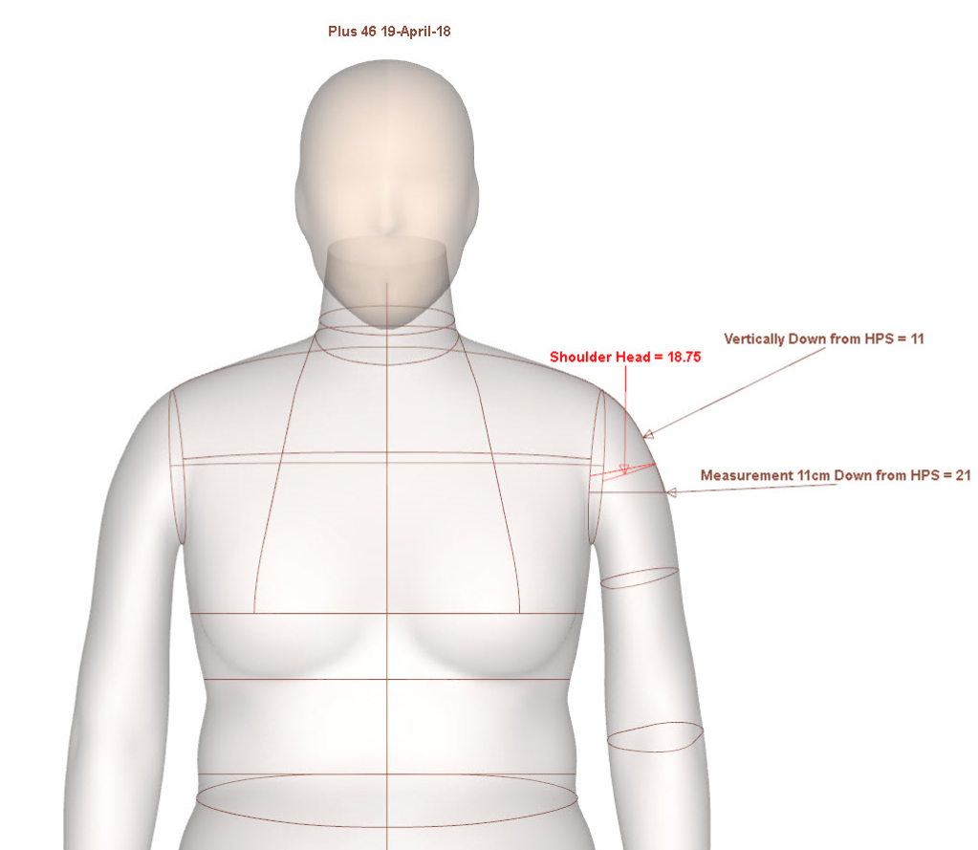

Slide 12
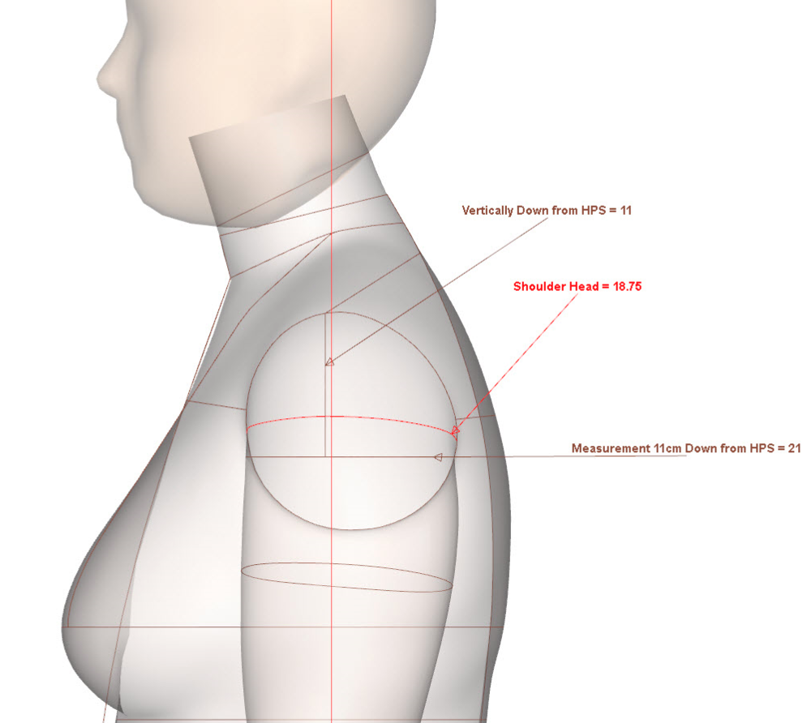

Slide 13
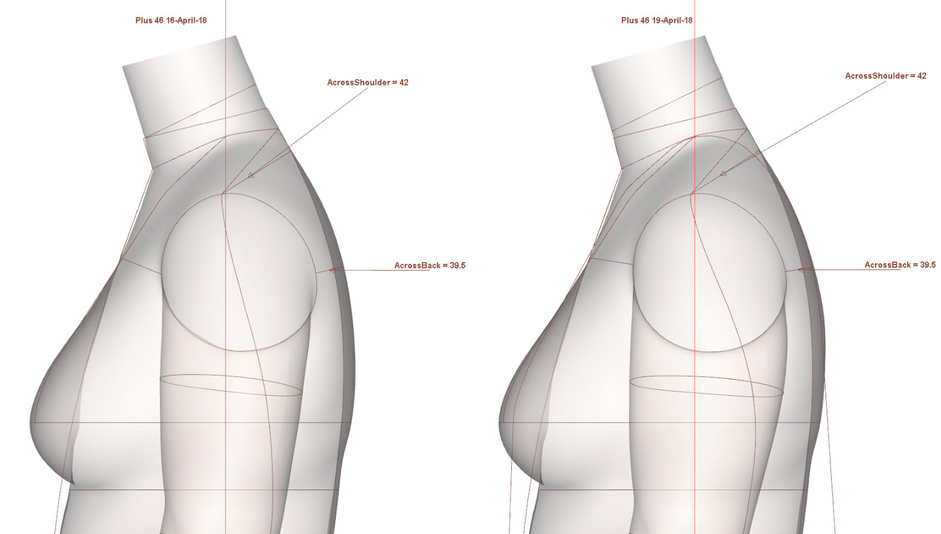

Slide 14
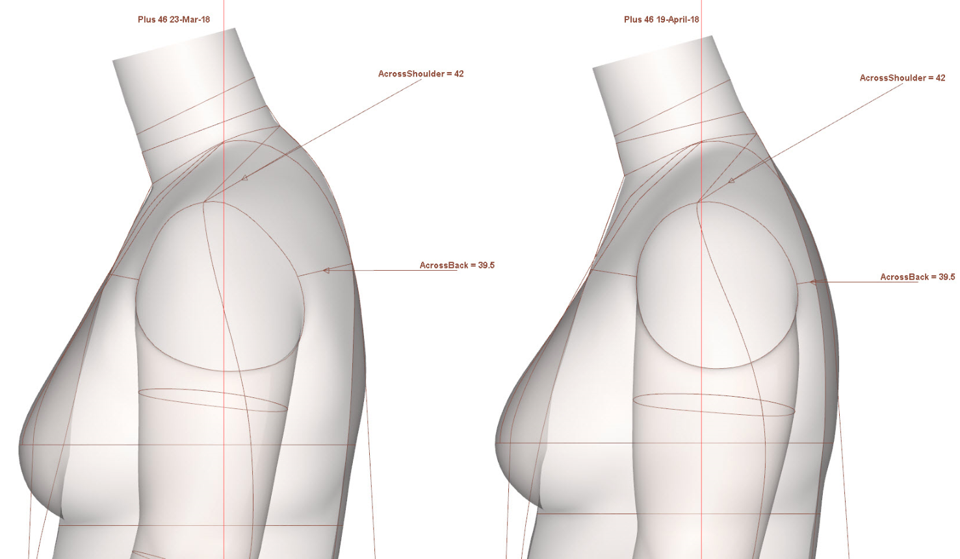

Slide 15
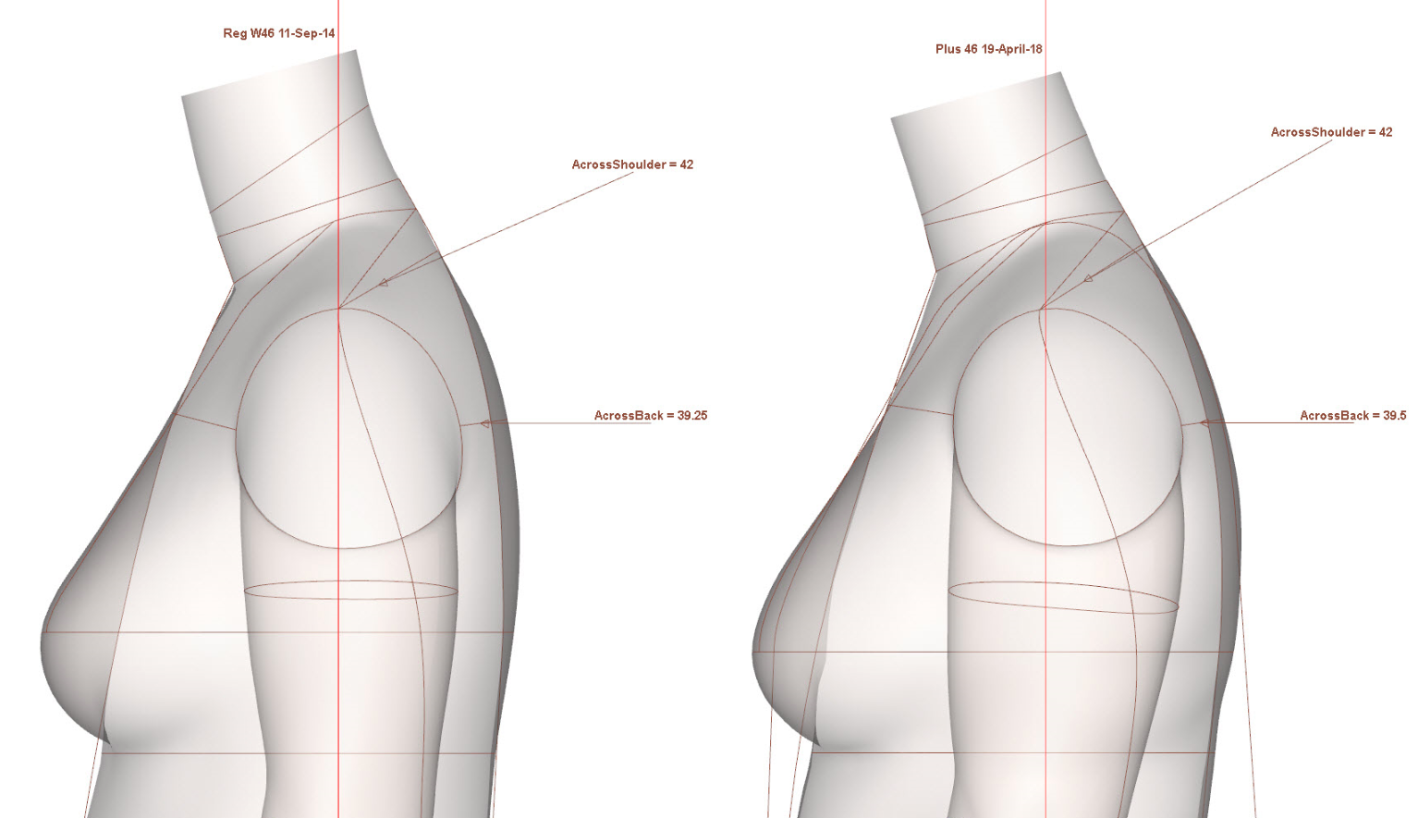

Slide 16
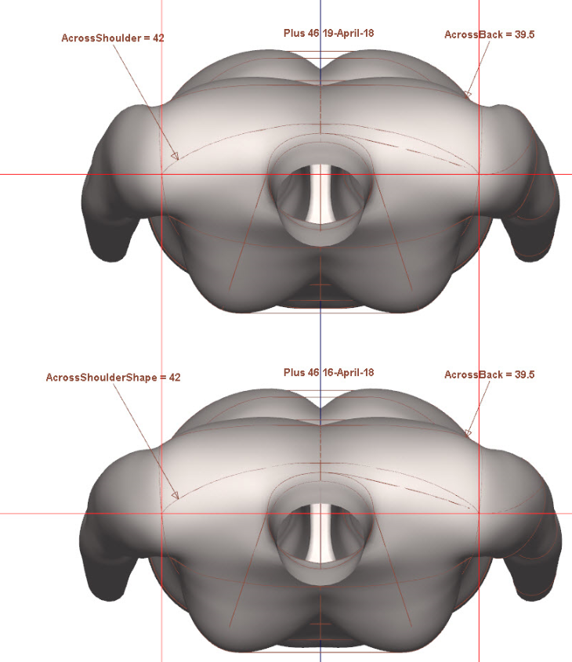

Slide 17
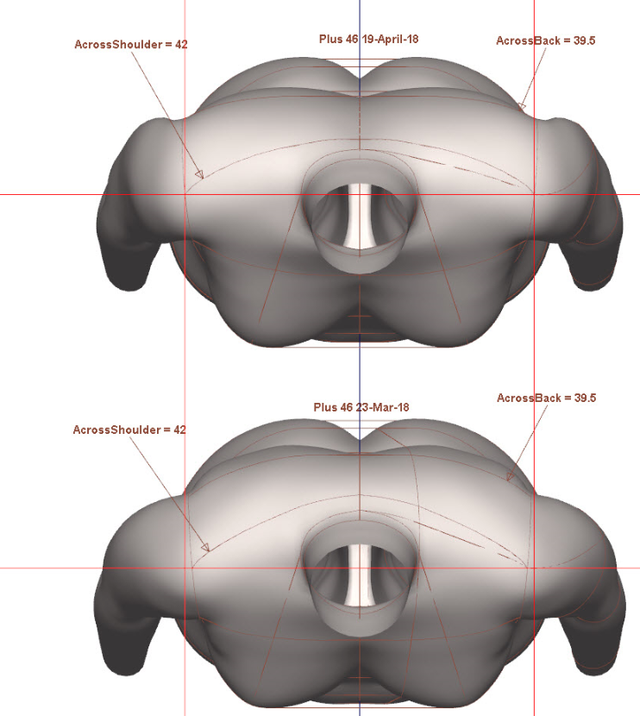

Slide 18
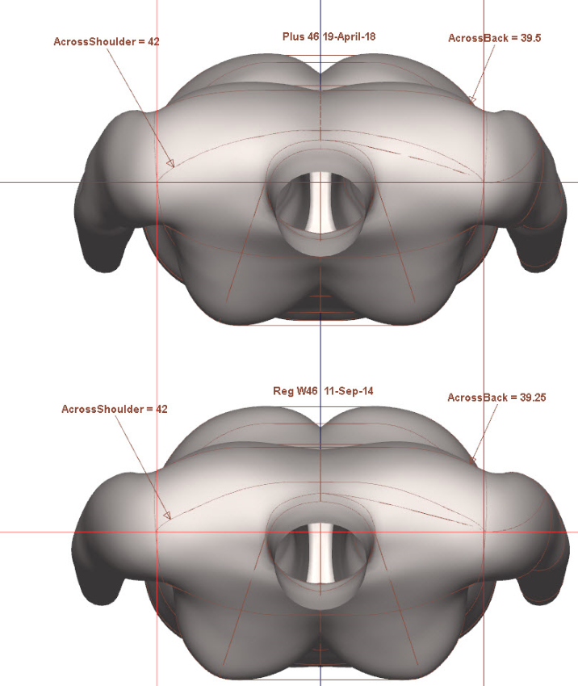

Slide 19
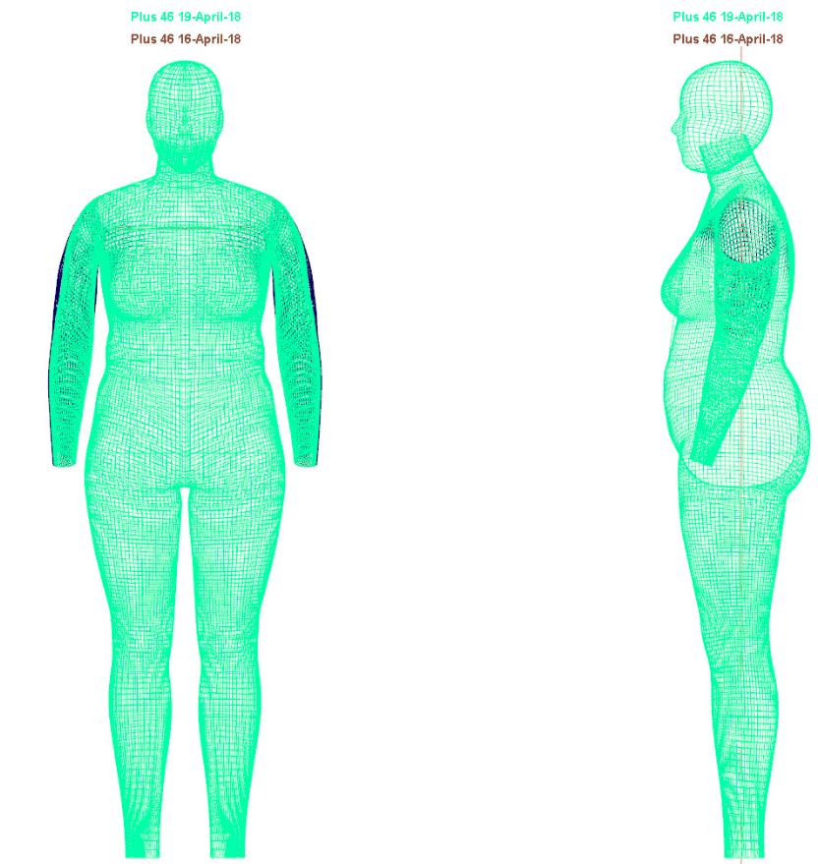

Slide 20
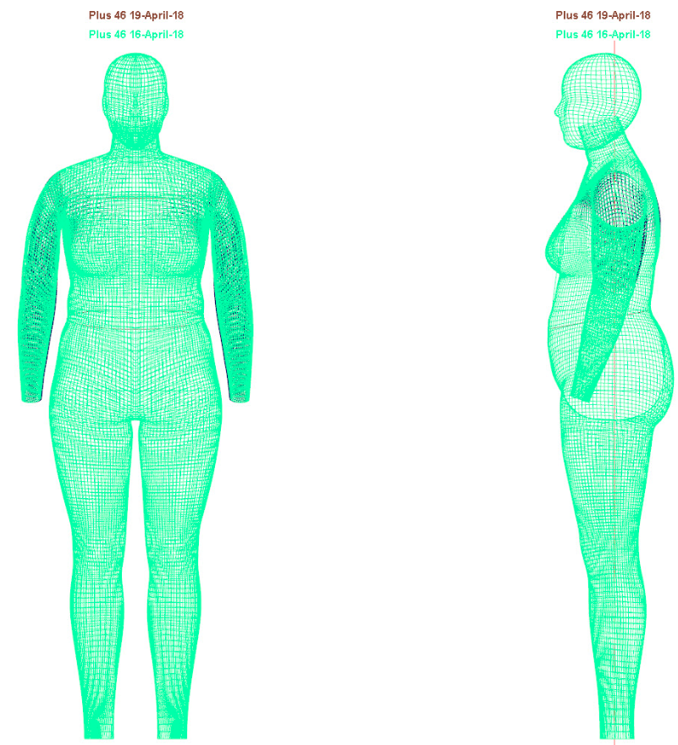

Slide 21
Consulting@alvanon.com
Alvanon, Inc.
+1 212 868 4318

Slide 22
Title for Layout 0
Placeholder index:10 type:Picture Placeholder 3
Placeholder index:1 type:Subtitle 1
Placeholder index:11 type:Text Placeholder 4

Slide 23
Title for Layout 1
Placeholder index:10 type:Picture Placeholder 3
Placeholder index:1 type:Subtitle 1
Placeholder index:11 type:Text Placeholder 4

Slide 24
Title for Layout 2
Placeholder index:10 type:Picture Placeholder 3
Placeholder index:1 type:Subtitle 1
Placeholder index:11 type:Text Placeholder 4

Slide 25
Title for Layout 3
Placeholder index:10 type:Picture Placeholder 3
Placeholder index:1 type:Subtitle 1
Placeholder index:11 type:Text Placeholder 4

Slide 26
Title for Layout 4

Slide 27
Title for Layout 5

Slide 28
Title for Layout 6
Placeholder index:12 type:Text Placeholder 2

Slide 29
Title for Layout 7
Placeholder index:1 type:Text Placeholder 2

Slide 30
Placeholder index:24 type:Text Placeholder 4
Placeholder index:25 type:Text Placeholder 5
Placeholder index:26 type:Text Placeholder 6
Placeholder index:20 type:Text Placeholder 1
Placeholder index:21 type:Text Placeholder 2
Placeholder index:23 type:Text Placeholder 3

Slide 31
Title for Layout 9
Placeholder index:13 type:Text Placeholder 2
Placeholder index:12 type:Picture Placeholder 1
Placeholder index:1 type:Content Placeholder 4

